Slide 1
jQuery

Slide 2
Agenda
What is the jQuery?
Wrapped Set
Useful API
DOM selection
DOM traversal
DOM creation
DOM events

Slide 3
jQuery
“Write less, do more”
Open source JavaScript library
Released at 2006
Provides CSS 3 based syntax for DOM traversing
Eliminates cross-browser differences
Extensible
Making DOM manipulation easier
http://jquery.com/

Slide 4
Why jQuery ?
You have no other choice ☺
Open source
Free
Adopted by many leading companies
Easy to integrate into existing application
IE6+ (Wow …)
Very active community
Lightweight

Slide 5
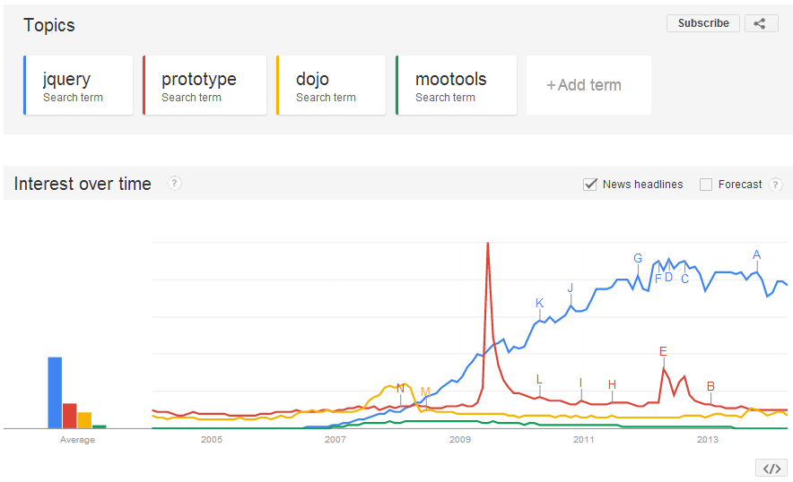
Alternatives

Slide 6
Getting Started
Download jQuery script from http://jquery.com/
Compressed
Uncompressed
Can use CDN instead of local script
Google
Microsoft
jQuery
Include it in your HTML
Start using the jQuery global object

Slide 7
jQuery Global Object
It is actually a function
Has and alias named $
There are different ways to use it
$(“div”) – Search
$(“<div />”) – Create
$(function(){…}) – DOM Ready
$(element) – Wrap native DOM element
$.ajax – Global API
See next slides

Slide 8
$ Conflicts
$ alias is not reserved for jQuery
Other 3rd party libraries might use it too
How can we ensure no conflicts ?
Use closure
Never use the global $
(function ($) {
// $ here is for sure jQuery
// Ask jQuery to restore original $ value
// Can omit this line
$.noConflict();
})(jQuery);

Slide 9
Initialization
Most of the time we are using jQuery for DOM manipulation
For example, animation
To manipulate the DOM we must first wait for it to be completely loaded
There is a standard DOM event named DOMContentLoaded
However, is not supported under old browsers IE8-

Slide 10
Waiting for the DOM
jQuery offers cross browser DOM ready event
On new browsers it uses DOMContentLoaded
Old browsers require some nasty tricks
Two ways to do the same thing
<script>
$(document).ready(function () {
alert("DOM is ready");
});
$(function () {
alert("DOM is ready");
});
</script>

Slide 11
DOM Selection
Construct a CSS selector
Send it to $ as a string
jQuery looks for all matching elements
Returns an array of results
A.K.A jQuery wrapped set
Offers a rich API
// Change all links color to red
var res = $("a");
res.css("color", "red");

Slide 12
DOM Selection
Select according to class
Select according to html tag
Select according to id
Combination of above
$(".items")
$(“div")
$(“#button1")
$(“#main input.simpleButton")

Slide 13
Wrapped Set – Be Aware
jQuery wrapped set is an array of DOM elements
Not array of jQuery objects !!!
$(function () { var set = $(".items .item"); for (var i = 0; i < set.length; i++) { var item = set[i]; alert(item.innerHTML); } });

Slide 14
Method Chaining
Most jQuery functions return the original result set
This allow us to chain method calls
This style of writing is very popular amongst jQuery developer
However, code is not clear
//
// Change all links color to red and text to XXX
//
$("a").css("color", "red").text("XXX");

Slide 15
Attribute selectors
Attribute starts with
Attribute contains
Attribute equals
Has attribute
$(".item[type^=button]”)
$(".item[type*=button]”)
$(".item[type=button]”)
$(".item[type]”)

Slide 16
Pseudo selectors
Select even element
Select N child
Do not match
$(“tr:even”)
$(“tr:nth-child(3n)”)
$(“input:not([type=button])”)

Slide 17
Form Selectors
Input tags of type button and buttons tags
All input tags, select, and textarea
Only checked checkboxes and radio buttons
Selected option inside select tad
$(“:button”)
$(“:input”)
$(“:checked”)
$(“:selected”)

Slide 18
Position Selectors
Select by index
Select elements with index greater than
Select elements with index less than
Select first and last element
$(“div:eq(2)”)
$(“div:gt(1)”)
$(“div:lt(4)”)
$(“div:first”) $(“div:last”)

Slide 19
Working with a jQuery Object
Assuming you hold a reference to jQuery object
You can invoke any of jQuery DOM element APIs
Too many to cover
Important ones
html & text
css & addClass
attr & prop
bind & delegate & on

Slide 20
html vs. text
Get/set the content of an element
Get/set the text of an element
All tags are removed
$(“div”).html()
$(“div”).html(“New Content”)
$(“div”).text()
$(“div”).text(“New Text”)

Slide 21
Styling - css
Get/set the inline styles of an element
Multiple styles
$(“div”).css(“background-color”)
$(“div”).css(“background-color”, “red”)
$("button").css({
color: "red",
"font-size": "2em",
});

Slide 22
Styling - addClass
Using css method is considered poor design
Managing inline-styles at runtime is complex
You should consider adding a CSS class to the element and set the styles on this class
Use hasClass to determine if a CSS class is present on an element
<style>
.btn {
color: red;
font-size: 2em;
}
</style>
$(document).ready(function () {
$("button").addClass("btn");
});

Slide 23
Attributes
Get/set the value of a specific attribute
Returned value may be a
string – Attribute’s value
undefined – Attribute is not present on the element
Attribute may be empty
Hence, below code is problematic
$(“div”).attr(“checked”)
if (!$("input").attr("xxx")) {
// Not sure if attribute is missing or just empty
}
<input type="checkbox" xxx />

Slide 24
Size & Position
width/height – Content size
Read/write API
innerWidth/innerHeight – Include padding
outerWidth/outerHeight – Include border
Send true to include margin too
position – Relative to its non static parent
Read-only
offset – Relative to the document
Read/write

Slide 25
DOM Traversal
Search inside a DOM element
Get only direct children
Get the list of parent elements
Get sibling elements
$(".items").find(".item")
$(".items").children(".item");
$(".items").parents();
$(".items").siblings();

Slide 26
DOM Traversal (2)
Previous sibling element
Next sibling element
Get the list of parent elements
The first matching ancestor
$(“#header").prev()
$(“#header").next()
$(".items").parents();
$(".items").closest(“li");

Slide 27
DOM Creation
Construct HTML string and send it to $
Get back a reference to the newly created DOM element
The newly created element is detached from the DOM
Insert the new element into the document
var button = $("<button>Click Me</button>");
$("body").append(button);

Slide 28
DOM Creation Techniques
Append HTML string
Create and appendTo
Other techniques
Before/insertBefore
after/insertAfter
prepend/prependTo
replaceWith/replaceAll
$("body").append("<button>Click Me</button>");
$("<button>Click Me</button>").appendTo("body");

Slide 29
Moving Element
No special API
Select existing element
Append it to another → It will be moved not copied
If target is an array the moved element will be removed and then copied to all targets
$("button").appendTo("div");

Slide 30
Removing Element
Clear content – The element itself is not removed
Totally Remove an element
Remove an element but keep any jQuery related data
Event handlers
Attached user data
$(“#header").empty()
$(“#header").remove()
$(“#header").detach();

Slide 31
Event Handling
Native DOM offers the addEventListener API
jQuery offers several methods instead
bind/unbind
delegate/undelegate
live/die
on/off
on/off is the latest and can be used instead of all others

Slide 32
bind
Accepts the following
Event name – click, blur, focus, …
Data object – User defined state
Is used rarely
Callback – A function to be invoked when event is raised
var input = $("input");
input.bind("click", function () {
alert("Button was clicked");
});

Slide 33
unbind
Registering event handler means that the DOM holds a reference back to your objects
This reference holds your objects alive
When building SPA it is important to clear event handlers to allow GC collection
// specific handler
input.unbind("click", handler);
// all handlers for a specific event
input.unbind("click");
// all handlers for all events
input.unbind();

Slide 34
Bind Shortcuts
For some common events, jQuery offers shortcut methods instead of bind
click
dblclick
blur
focus
keywodn/keyup/keypress
mouseup/mousedown
Change
More …
$("button").click(function () {
console.log("Button was clicked");
});

Slide 35
What did happen to my this ?
Inside a DOM event handler the this keyword points to the DOM element that raised the event
Consider wrapping it inside jQuery object
Get back access to all jQuery APIs
$("button").click(function () {
// outputs true
alert(this.nodeName == "BUTTON");
});
$("button").click(function () {
var button = $(this);
alert(button.text());
});

Slide 36
Event Handler inside a Class
Writing Object Oriented JavaScript and handling DOM event is tricky
function HomeView(element) {
this.element = element;
this.buttonLogin = this.element.find("button.login");
this.buttonLogin.click(this.login_Clicked);
}
HomeView.prototype.login_Clicked = function () {
// Exception is thrown here, why ?
this.buttonLogin.attr("disabled", "disabled");
}
$(document).ready(function () {
var homeView = new HomeView($(".home-view"));
});
<body>
<div class="home-view">
<button class="login">Login</button>
</div>
</body>

Slide 37
Event Object
An optional object that is sent to the event handler
Contains information about the event itself
Mouse position, Keyboard state, …
jQuery normalizes the event, ensuring that all standard properties exist
$(document).ready(function () {
$("button").click(function (e) {
// True if alt key was pressed during button click
console.log(e.altKey);
});
});

Slide 38
Event Object is a Clone
jQuery clones the browser’s original event object and normalizes it
To get access to non standard fields that are not copied by jQuery
Use originalEvent
Or, ask jQuery to always copy field from original object
$("button").click(function (e) {
console.log(e.originalEvent.dataTransfer);
});
jQuery.event.props.push("dataTransfer");

Slide 39
Challenge
Suppose we have a table with 5000 rows
We want to handle dblclick on each row
Naïve solution
Bad performance
Selecting 5000 DOM elements into memory
Invoking addEventListener 5000 times
$("table tr").dblclick(function () {
alert("Row was double clicked");
});

Slide 40
Solution
Register dblclick handler only once
On the root table element
The browser propagates dblclick events from a DOM element to its parents hierarchy
Cons
Not clear which row was clicked
The handler is invoked even when clicking on non row element
Not every DOM event is propagated
$("table").dblclick(function () {
alert("Row was double clicked");
});

Slide 41
delegate
Installs event handler on a root object
The handler is invoked only when source DOM element matches a specified selector
The this reference points to the clicked row
Not to the table
$("table").delegate("tr", "click", function () {
// this is row not a table
var row = $(this);
});

Slide 42
live
A deprecated method
Same as delegate but the root object is always the document
Therefore less optimized
You might still encounter it in old jQuery based code
live was removed from jQuery 1.9 !!!
$("tr").live("click", function () {
var row = $(this);
});

Slide 43
on
A replacement for bind and delegate
An overloaded method
bind like usage
delegate like usage
$("tr").on("click", function () {
console.log("Row was clicked");
});
$("table").on("click", "tr", function () {
console.log("Row was clicked");
});

Slide 44
Summary
jQuery is a de-facto standard for DOM manipulation
Many 3rd party libraries are using it
Telerik
Angular
Is a library, not a framework
Easy to integrate into existing code
However, does not help you with modeling/layering

